Slide 1
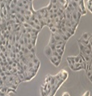
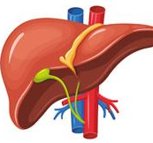
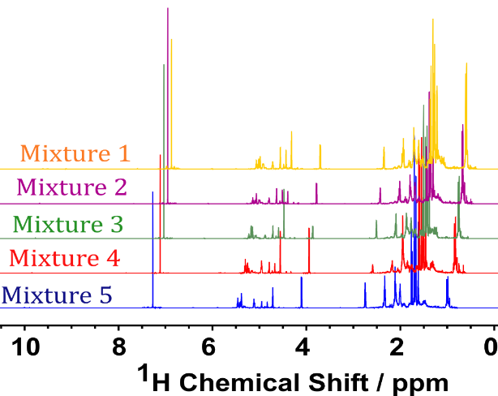
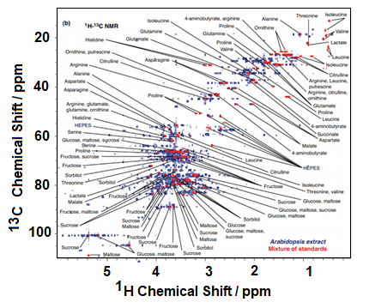
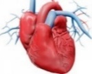
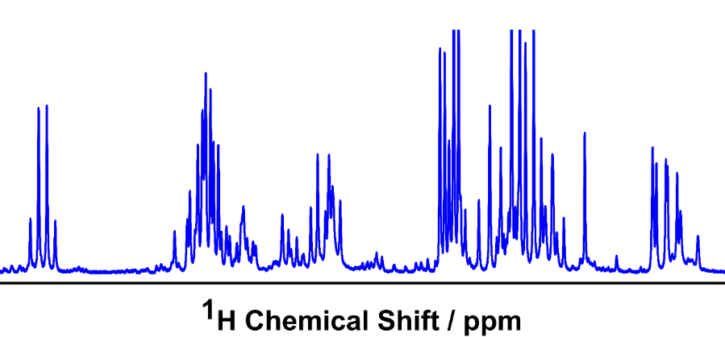
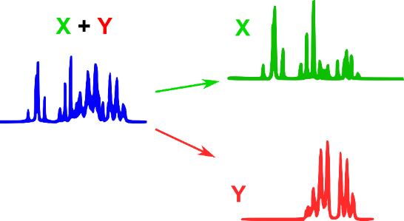
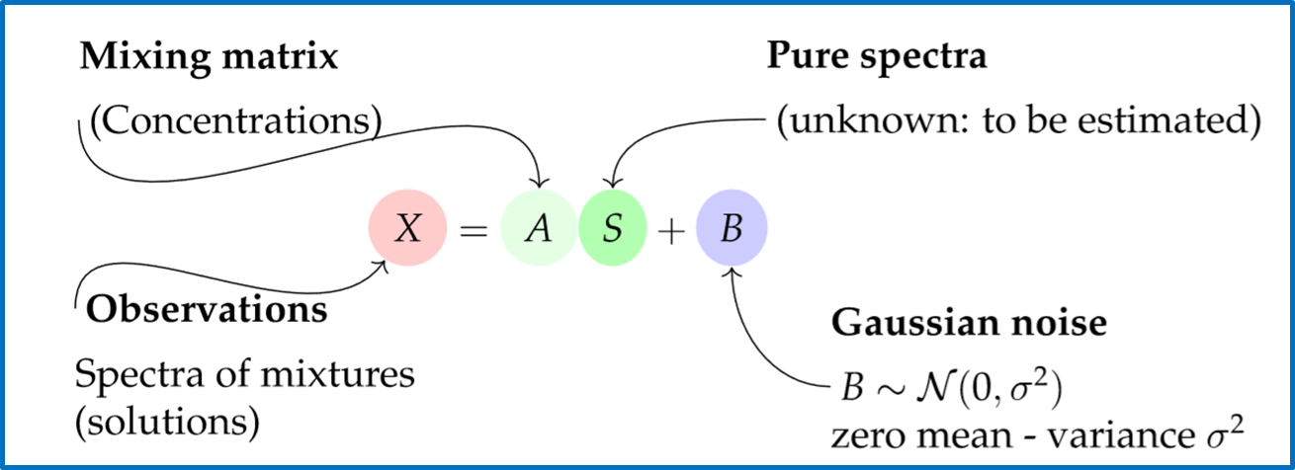
Challenges in the decomposition of NMR spectra of small molecule mixtures
E. Piersanti¹, A. Cherni², S. Anthoine², C. Chaux², L. Shintu¹, M. Yemloul¹ and B. Torrésani¹
¹Aix Marseille, CNRS, Centrale Marseille, iSM2, Marseille, France. 52 Avenue Escadrille Normandie Niemen, 13013 Marseille.
²Aix Marseille Univ, CNRS, Centrale Marseille, I2M, Marseille, France. Château Gombert – 39 rue F. Joliot Curie – 13453 Marseille.
Context:
Complex spectra : overlaps
2D
Results:
1D
A+B+C+D
1D
Variable concentrations
5 mixtures used to estimate the 4 sources
BSS
A
Objective:
to decompose mixture into pure spectra using
signal processing with Blind Source Separation
B
Mathematical tools: modeling
C
D
Results on ¹H NMR spectra. Estimated sources versus real sources of the 5 mixture spectra with variable concentrations of the 4 terpenes.
A. Cherni, E. Piersanti, S. Anthoine, C. Chaux, L. Shintu, M. Yemloul, B. Torrésani, Faraday Discuss. 2019, 218, 459-480.

